Slide 1
NodeJS Fundamental (session 1)
Tran Minh

Slide 2
Agenda
What Is Node?
Introduce
How do I install Node.js?
Using nvm
When Should I Use It?
Execution Model
Single-thread
What kind of Apps is Node.js is suited to?
Build a Simple Page Counter Service with Node.js
Q&A

Slide 3
What Is Node?

Slide 4
What Is Node.js?
Focus Items
Introduce
NodeJS Interpreter online
How do I Install NodeJS?
Using nvm

Slide 5
Introduce
A JavaScript runtime
Built on Chrome’s V8 JavaScript engine
Open-source JavaScript engine
Google Chrome and other Chromium-based web browsers (Brave, Opera, Vivaldi, etc.)
Designed with performance in mind and is responsible for compiling JavaScript directly to native machine code.
NodeJS:
Event-based
Non-blocking
Asynchronous I/O runtime

Slide 6
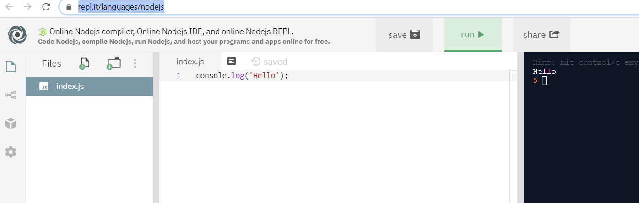
NodeJS interpreter online
Link: https://repl.it/languages/nodejs

Slide 7
How Do I install NodeJS?
Install Multiple Versions of Node.js using nvm
Windows
Uninstall any existing versions of Node.js
Delete any existing Node.js installation directories (such as C:\Program Files\nodejs)
Delete the existing npm install location (such as C:\Users\<user>\AppData\Roaming\npm)
After this, download and run the latest stable installer and you should be good to go!
macOS/Linus

Slide 8
How Do I install NodeJS? (2)
macOS/Linus
With cURL:
With Wget:
This will clone the nvm repository to ~/.nvm and will make the required changes to your bash profile, so that nvm is available from anywhere in your terminal.
curl -o- https://raw.githubusercontent.com/creationix/nvm/v0.35.2/install.sh | bash
wget -qO- https://raw.githubusercontent.com/creationix/nvm/v0.35.2/install.sh | bash

Slide 9
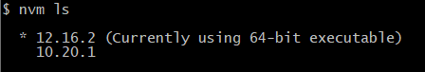
Using nvm
Install node version
List all node installed
Use specific node version
Check it
nvm install 12.16
nvm ls
nvm use 12.16.2
node –v npm -v

Slide 10
When Should I Use It?

Slide 11
When Should I Use It?
Focus Items
Node.js let us run JavaScript on the Server
Execution Model
Node.js is single-threaded
What kind of Apps is Node.js Suited to?
Other Uses of Node

Slide 12
Run JavaScript on the Server
Not a new concept
First attempted by Netscape way back in 1994.
Node.js, however, is the first implementation to gain any real traction. Provides some unique benefits, compared to traditional languages
Node now plays a critical role in the technology stack of many high-profile companies

Slide 13
Execution Model
Node.js is single-threaded but in the background, it uses multiple threads to execute asynchronous code with the help of the libuv library.
It’s also event-driven, which means that everything that happens in Node is in reaction to an event
New request comes in (one kind of event) the server will start processing it
If it then encounters a blocking I/O operation, it will register a callback before continuing to process the next event
When the I/O operation has finished (another kind of event), the server will execute the callback and continue working on the original request
Notes:
In very simplistic terms, when you connect to a traditional server, such as Apache, it will spawn a new thread to handle the request
the server has to wait for the database lookup to complete before it can move on to processing the result
If new requests come in while this is happening, the server will spawn new threads to deal with them
The most common way to support more connections is to add more servers.

Slide 14
2
The event loop efficiently manages a thread pool and executes tasks efficiently…
Node apps pass async tasks to the event loop, along with a callback
1
C++ Thread Pool
Thread 1
Thread 2
Thread n
(function, callback)
…
Node.js
Event Loop
(single-thread)
Task 1
Task 2
Node.js app
Task 3
Return 1
Callback1()
Task 4
3
… and executes each callback as tasks complete

Slide 15
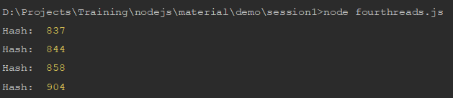
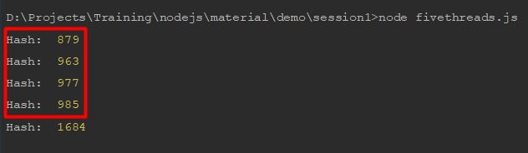
Node.js is single-threaded
We will run test with `fourthreads.js` and `fivethreads.js` and view the result (CPU: 4 process)
Four threads (fourthreads.js)
Five threads (fivethreads.js)

Slide 16
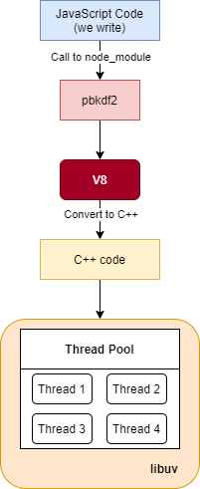
Node.js is single-threaded (2)

Slide 17
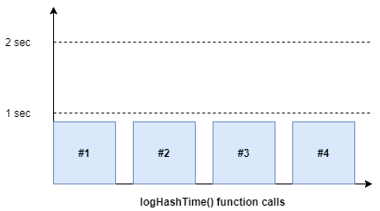
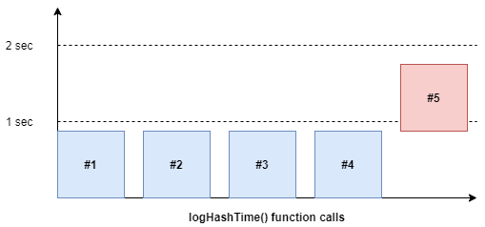
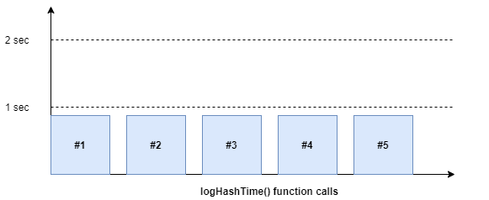
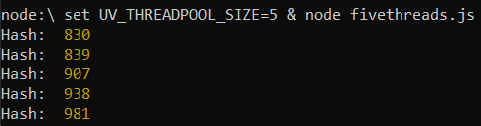
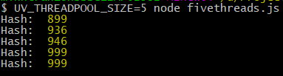
Code run-time
Notes:
UV_THREADPOOL_SIZE=5 node fivethreads.js

Slide 18
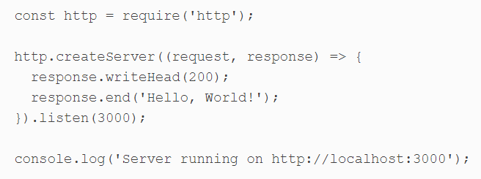
Hello World – Server version
Hello-world-server.js
Run command

Slide 19
What kind of Apps is Node.js is suited to?
Real-time interaction or Collaboration (chat, codeshare)
API handles lots of requests that are
I/O driven (such as those needing to perform operations on a database)
Sites involving data streaming (Node makes it possible to process files while they’re still being uploaded)
Simple CRUD app. (There’s a lot of frameworks that support us to build CRUD app)

Slide 20
Other Uses of Node
Used as a scripting language:
For automate repetitive tasks on your PC
For error prone tasks
Write your own command line tool
Build cross-platform desktop apps
Create your own robots

Slide 21
Build a Simple Page Counter Service with Node.js

Slide 22
Build a Simple Page
Focus Items
Prerequisites
Page Hit v1.0: In-memory Storage
Page Hit v2.0: File Storage

Slide 23
Prerequisites
Download and install Node.js on platform of your choice.
You can also use a version manager such as nvm
The latest LTS Node release is a good choice
Install nodemon: can used to launch and restart Node.js applications whenever source code is changed
Install small-static-server (ss): can be used in any directory to launch a static, file-based web server
npm install -g nodemon
npm install -g small-static-server

Slide 24
Page Hit v1.0
Source Control (Optional)
Step 1: Initialization
Step 2: Main file (index.js)
Step 3: Additional Modules
Step 4: Test page

Slide 25
Step 0: Source Control
Source control applications such as Git help to back up code and manage revisions. (GitHub, BitBucket, GitLab, etc.)
We should have .gitignore to avoid not-commit files/ folders.
We will have node_modules/ folders when we run `npm install`, we should ignore this folder too.

Slide 26
Step 1: Initialization
Create a new folder, run `npm init` to create `package.json`
Input information for `package.json`. Update “scripts” section:
> npm start → start script
> npm run debug → using nodemon to monitor file changes and reports full stack traces
mkdir project1
cd project1
npm init
"scripts": {
"debug": "nodemon --trace-warnings ./index.js",
"start": "node ./index.js",
"test": "echo \"Error: no test specified\" && exit 1"
},

Slide 27
Step 2: Main file (index.js)
Create `index.js` file
> npm run debug
Wait for the message: “page hit …”.
Load http://localhost:3000/hello/world
'use strict’; const port = 3000, http = require('http'), url = require('url'); // new server http.createServer((req, res) => { let uri = url.parse(req.url).pathname; res.end(uri); }).listen(port); console.log(`page hit web service running on port ${port}`);

Slide 28
Step 3: Additional Modules
It’s practical to split code into other files with reusable chucks of related functionality
Create a new lib directory
Create lib/httppreferrer.js
'use strict'; const url = require('url'), crypto = require('crypto'); module.exports = (req) => { let r = url.parse(req.headers.referer || ''), ref = r.href ? r.protocol + r.host + r.pathname : null; return ref ? crypto.createHash('md5').update(ref).digest('hex') : null; };
Notes:
exports a function which accepts an HTTP request object as a parameter. If this object has a referer set, the function will concatinate its protocol, host and pathname values, then return a 32-character MD5 hash of this string

Slide 29
Step 3: Additional Modules (2)
Create lib/httpresponse.js
'use strict'; module.exports = ({ res = null, status = 200, mime = 'text/plain', content = '' }) => { res.writeHead(status, { 'Access-Control-Allow-Origin': '*', 'Content-Type': mime, 'Cache-Control': 'must-revalidate, max-age=0', 'Content-Length': Buffer.byteLength(content) }); res.end(content); };
Notes:
exports a function which, when passed an object containing an HTTP response object, responds with the appropriate HTTP headers and content
Note that Access-Control-Allow-Origin is a cross-origin resource sharing (CORS) header which allows any page to use the page hit service.

Slide 30
Step 3: Additional Modules (3)
Create lib/pagehit.js
const httpReferrer = require('./httpreferrer'); module.exports = class { // initialize constructor() { // counter storage this.counter = {}; } // increase URL counter count(req) { let hash = httpReferrer(req); if (!hash) return null; // define count default this.counter[ hash ] = this.counter[ hash ] || 0; // return incremented count return ++this.counter[ hash ]; } };
Notes:
When the count() method is passed an HTTP request object, it generates a hash (using lib/httpreferrer.js above). This is used to initialize and increment a property of the this.counter object which has its total count value returned.

Slide 31
Step 3: Additional Modules (4)
'use strict'; const // default HTTP port port = 3000, // Node.js modules http = require('http'), url = require('url'), // page counter object pagehit = new (require('./lib/pagehit'))(), // HTTP response httpResponse = require('./lib/httpresponse'); // new server http.createServer((req, res) => { // get referring page count let count = pagehit.count(req); // error: referring page not found if (!count) { httpResponse({ res, status: 400, content: 'No referrer' }); return; } // send appropriate response let uri = url.parse(req.url).pathname; switch (uri) { // JavaScript document.write() counter case '/counter.js': httpResponse({ res, mime: 'application/javascript', content: `document.write('<span class="pagecounter">${count}</span>');` }); break; // error: invalid HTTP request default: httpResponse({ res, status: 404, content: 'Not found' }); break; } }).listen(port); console.log(`page hit web service running on port ${port}`);
Update index.js, and run “npm run debug”
Notes:
The line pagehit = new (require('./lib/pagehit'))() initializes an object from the lib/pagehit.js class, so the count() method can be called in the server function.
The switch() statement handles routing. In this case, only requests to /counter.js are valid; a JavaScript document.write() statement is returned, which outputs the value of count.

Slide 32
Step 4: Test page
Create another folder, such as testpages. Create file page-jswrite.html
<!DOCTYPE html> <html lang="en"> <head> <meta charset="UTF-8"> <title>page hits</title> </head> <body> <p> This page has been viewed <script src="http://localhost:3000/counter.js"></script> times. </p> </body> </html>
Notes:
The line pagehit = new (require('./lib/pagehit'))() initializes an object from the lib/pagehit.js class, so the count() method can be called in the server function.
The switch() statement handles routing. In this case, only requests to /counter.js are valid; a JavaScript document.write() statement is returned, which outputs the value of count.

Slide 33
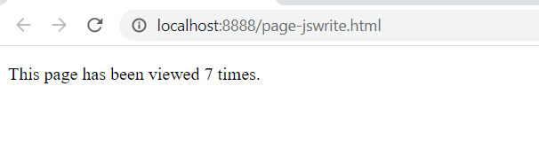
Step 4: Test page (2)
Run ss from this folder in another terminal:
Start a static file web server at http://localhost:8888
cd testpages
ss
server address: http://localhost:8888
root folder : ./testpages/
Notes:
The line pagehit = new (require('./lib/pagehit'))() initializes an object from the lib/pagehit.js class, so the count() method can be called in the server function.
The switch() statement handles routing. In this case, only requests to /counter.js are valid; a JavaScript document.write() statement is returned, which outputs the value of count.

Slide 34
Page Hit v2.0
Step 1: File utilities
Step 2: Modify lib/pagehit.js
Step 3: Test

Slide 35
File Storage
Solutions
Create data directory to store counters. (add data/ to .gitignore file.)
The server will trigger a save event after ten seconds. (this ensures saving occurs as a background task and is throttled during times of high load.)
`this.counter` of pagehit.js is converted to a JSON string and saved to a file with a unique name (based on the current date/time)
Once the file has successfully saved, all previously saved files are deleted from the data directory.
The application looks the most recent JSON file in the data directory and imports into `this.counter`
Storing page counters in memory means they reset every time the Node.js application is restarted

Slide 36
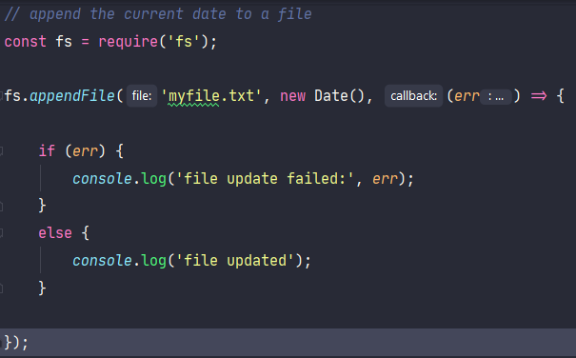
Node.js File System API
Node.js provides an extensive File System (fs) API which can manipulate, read, and write files and directories.
As default, Node.js use asysnc

Slide 37
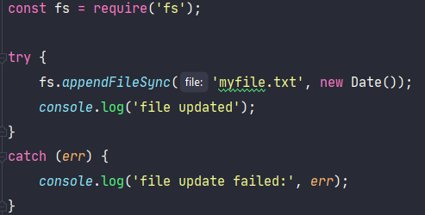
File system with sync
Synchronous 'sync' equivalents are also available
These are not Promise-based and block the entire Node.js process until they complete
For older releases of Node.js

Slide 38
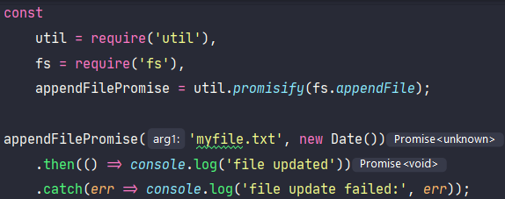
Promisify with file system function
It’s possible to Promisify any file system function using util.promisify

Slide 39
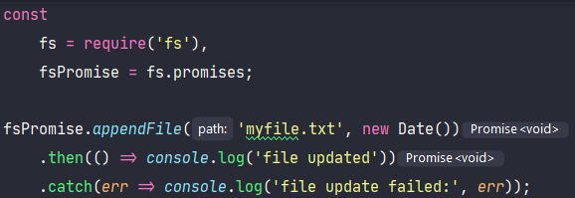
Promisify with file system function (2)
However, this is no longer necessary in recent versions of Node.js, because fs.promises provides Promise-based equivalents of all file system functions

Slide 40
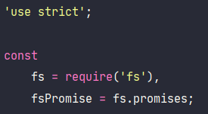
Step 1: File utilities
Create lib/fileutil.js
Use `fs` module for file process
Create info() function to return information of a file or directory, such as its type, permission, and creation time. It uses two fs functions:
access(path, mode): can test for existence, read, and write permissions
stat: returns meta information including the type (file or directory) and creation time.

Slide 41
Step 1: File utilities (2)
// returns information about a file/folder function info(fn) { const file = { path: fn, exists: false, read: false, write: false, isFile: false, isDir: false, time: 0 }; // If the accessibility checks are successful, Promises are resolved with no value return Promise.all([ fsPromise.access(fn, fs.constants.F_OK), fsPromise.access(fn, fs.constants.R_OK), fsPromise.access(fn, fs.constants.W_OK) ]) .then(fInfo => { file.exists = !fInfo[0]; if (!file.exists) return file; else { file.read = !fInfo[1]; file.write = !fInfo[2]; // Promise is resolved with the fs.Stats object for the given path return fsPromise.stat(fn) .then(fStat => { file.isFile = fStat.isFile(); file.isDir = fStat.isDirectory(); file.time = fStat.mtimeMs; return file; }) .catch(() => file); } }) .catch(() => file); }

Slide 42
Step 1: File utilities (3)
A folderUsable() function uses info() to check whether a directory exists, creates it if necessary, and returns information object.
The fs mkdir method is used to create the directory.
// return folder info object if it can be used async function folderUsable(folder) { try { // fetch folder information let fInfo = await info(folder); // create folder if required if (!fInfo.isDir) { await fsPromise.mkdir(folder); fInfo = await info(folder); } // folder accessible? return (fInfo.isDir && fInfo.read && fInfo.write ? fInfo : false); } catch (err) { console.log('folderUsable error:', err); return false; } }

Slide 43
Step 1: File utilities (4)
A folderList() function returns an information object for every file in a directory.
The fs readdir method fetches all file name into an array.
// return a sorted array of info objects for all files in a folder async function folderList(folder, ext = '', sortBy = 'time') { try { // names of all files in folder let filelist = await fsPromise.readdir(folder); // fetch file info filelist = await Promise.all( filelist.map(async f => await info(folder + f)) ); // remove unreadable files and sort return filelist .filter(fn => fn.isFile && fn.read && fn.path.endsWith(ext)) .sort((f1, f2) => f2[sortBy] - f1[sortBy]); } catch (err) { console.log('folderList error', err); return false; } }

Slide 44
Step 1: File utilities (5)
A write() function uses fs writeFile method to output content to a file.
// create a file, returns true or false async function write(fn, content = '') { try { await fsPromise.writeFile(fn, content); return true; } catch (err) { console.log('write error', err); return false; } }

Slide 45
Step 1: File utilities (6)
An unlinkMany() function deletes all files passed in an array of path strings or information objects.
The fs unlink method is processed in parallel on all items
// delete an array of files, return array of true/false async function unlinkMany(fnlist) { return await Promise.all( fnlist.map(async fn => { try { await fsPromise.unlink(fn.path ? fn.path : fn); return true; } catch (err) { console.log('unlink error', err); return false; } }) ); }

Slide 46
Step 1: File utilities (7)
Finally, the public functions are exported for use in other modules
// public functions module.exports = { info, folderUsable, folderList, write, unlinkMany };

Slide 47
Step 2: Modify lib/pagehit.js
The original lib/pagehit.js file is modified to save counter data to a file
We will update constructor()
Class constructors can’t be async themselves, but can run immediately involved async functions
const fileUtil = require('./fileutil'), httpReferrer = require('./httpreferrer'), // default data folder path = require('path'), dataFolder = path.resolve('./data') + path.sep, // file save throttling - no more than every 10 seconds saveFrequency = 10 * 1000;
Notes:
The path module provides useful cross-platform file path-parsing functions. In this case, it’s used to obtain the absolute name of a directory for saving data (data in the project’s folder).

Slide 48
Step 2: Modify lib/pagehit.js (2)
Update constructor()
Set folder property to a file information object
Set the saved property to an array of information objects
If at least one .json file exists, import it using require
constructor() { // counter storage this.counter = {}; // counter storage this.counter = {}; (async () => { // store folder available? this.folder = await fileUtil.folderUsable(dataFolder); if (!this.folder) return; // fetch all JSON files sorted most recent first this.saved = await fileUtil.folderList(this.folder.path, '.json'); // import and merge latest data if (this.saved.length) { Object.assign(this.counter, require(this.saved[0].path)); } })(); }

Slide 49
Step 2: Modify lib/pagehit.js (3)
The count() method is changed to start a 10-second timer whenever a page counter is incremented
this.save() is called 10 seconds after the first update occurs
// increase URL counter count(req) { let hash = httpReferrer(req); if (!hash) return null; // define count default this.counter[ hash ] = this.counter[ hash ] || 0; // save event this.saveTimer = this.saveTimer || setTimeout(this.save.bind(this), saveFrequency); // return incremented count return ++this.counter[ hash ]; }
Notes:
this.save.bind(this) → this.save() will be called after `saveFrequency` time.

Slide 50
Step 2: Modify lib/pagehit.js (4)
The save() method does the following:
Convert counter property to a JSON string and saves to file.
If save successful, delete other files, keep only reference file.
The saveTimer property is reset so further saves become possible
// store latest data async save() { // can save if (!this.folder) return; // save new file let fn = `${this.folder.path}hit${+ new Date()}.json`; if (await fileUtil.write(fn, JSON.stringify(this.counter))) { console.log(`page hits stored: ${fn}`); // delete old files await fileUtil.unlinkMany(this.saved); // add current file to saved list this.saved = [{ path: fn }]; } // reset timer this.saveTimer = null; }
Notes:
this.save.bind(this) → this.save() will be called after `saveFrequency` time.

Slide 51
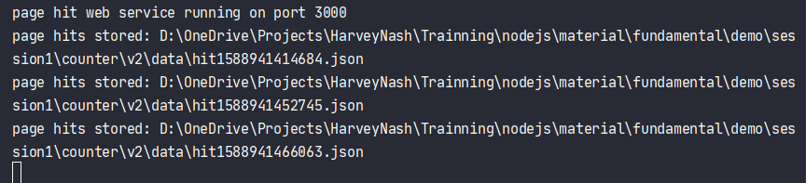
Step 3: Test
> npm run debug
Same test page, run ss

Slide 52
Job DONE?
The service is simplistic. It retains a total count, but couldn’t be used to determine how many people accessed within a period, such as today or this week
A counter for every page is always retained in memory. All OS processes have a memory limit and a busy service would eventually fail.
File handling is difficult, and a busy service would need to save many megabytes of data every few seconds. It would be possible to split data into multiple files or only append changed counters, but file handling would become even more complicated.
File saving can fail—for example, if disk space runs out or the process halts during a save operation. It may be possible to return to a previous file, but data would be lost.
Data is also lost if a counter is updated during a file save operation and the service is stopped soon afterwards!

Slide 53
Q&A

